Slide 1
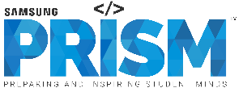
[Samsung PRISM] End Review Report
Malayalam NLU & ASR model for Rasa using Spacy, Fast Text, Jarvis
Team
College Professor(s) : Prof. Geetha (Assistant Professor) and Prof Jayanthi M.G (Associate Professor)
Students :
A Devipriya (1CD18EC001)
Abhijith (1CD19CS003)
Ashwin Suresh (1CD19CS027)
Alfred M Abraham (1CD19CS016)
Department : Electronics and Communication Engineering & Computer Science Engineering
Date: 1st February 2022

Slide 2

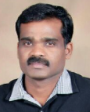
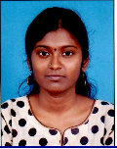
Work-let Area – AI, NLU/P, ASR | Malayalam NLU & ASR model for Rasa using Spacy, Fast Text, Jarvis
Problem Statement
Samsung is planning for a conversational framework based on AI, NLP/U and ASR which will be used by Samsung India. Lot of customers of this solution will have their primary language as Malayalam. Handling of all queries of these customers with Malayalam speaking agents is difficult to ensure all the time.
This new product is using Rasa and Spacy for providing an intelligent conversational UI for customers. One issue faced by the team is the absence of suitable language model in Malayalam. We are looking at developing a trained NLU model for Malayalam using transfer and multi task learning.
Samsung is looking at integrating a multimodal conversational interface with current conversational UI for improving customer experience. This new framework is looking a Jarvis model for Malayalam, which can be integrated with existing conversational UI .
Work-let expected duration – 6 months
Expectations
A Spacy NLU model for Malayalam, which can be integrated to conversational UI for customer service and sales in Malayalam speaking regions.
A Jarvis ASR and NLU model which can be integrated to conversational UI for enabling voice and video based automated interactions for Malayalam speaking customers.
Integration of Spacy and Jarvis models with Rasa for enabling a seamless experience for Malayalam speaking customers of .
Training/ Pre-requisites
Familiarity with machine learning frameworks (e.g., PyTorch, keras, Tensor Flow etc.)
Knowledge of semantic extraction, modelling and text representation
Familiarity with NLP frameworks ( like BERT) and NLP model development and deployment.
4
Members
Additional Documentation:
https://rasa.com
https://spacy.io
https://github.com/facebookresearch/fastText
https://developer.nvidia.com/blog/creating-voice-based-virtual-assistants-using-jarvis-and-rasa/
https://docs.nvidia.com/deeplearning/jarvis/user-guide/docs/service-nlp.html
Kick Off < 1st Month >
Understanding Machine Learning fundamentals and concepts.
Bring depth knowledge in NLP (Natural Language Processing) and ASR (Automatic Speech Recognition)
Understanding conversational UI
Study and expertise in Rasa, Spacy, Fast Text and Jarvis
Milestone 2nd 3rd Month >
Develop a Malayalam language model for using transfer learning and fasttext.
Train Samsung scripts using transfer learning techniques.
Integrate Spacy model for Samsung’s new product conversational interface.
Milestone 4th Month >
Develop a Malayalam language model for Jarvis.
Integrate Jarvis with Rasa and train Jarvis with Malayalam language scripts.
Integrate Jarvis model with Samsung’s new product conversational interface
Closure < 6th Month >
Performance evaluation and improvement of conversational UI in Malayalam using Botium.
Bench marking Spacy and Jarvis models against state of art models in Malayalam.
Final release with best performing conversational UI
Senthil Kumaran, Architect
senthil.kmrn@samsung.com
+91-9902211771
Gomathi Sengodan, Sr. Chief engineer II
gomathi.sen@samsung.com
+91-9731642465

Slide 3
Approach / Solution
Concept Diagram :
Understanding Anaconda
and setting up
environment for Rasa
Implementation of
Malayalam Chatbot
using Samsung
Datascripts
Validation and
accuracy test
using existing
stories
Understanding
structure of the
Chatbot &
building a basic
Malayalam Chatbot
Implementing
Malayalam Chatbot
using Fasttext
vectors & Spacy
Research on
alternatives for NVIDIA Riva(JARVIS)
& comparison
between Mozilla
Tools & Riva
Understanding Fasttext
and Spacy

Slide 4
Dataset(s) Analysis / Description
Dataset Capture / Preparation / Generation :
Datascripts were provided by Samsung.
The scripts contained all the intents, responses and functions required for the Bot to function.
Dataset Understanding / Analysis :
Read through the intents thoroughly.
Had gone through the domain file to check for responses for each intents individually.
Analysis of stories file to understand how the Bot is going to converse.
Dataset Pre-Processing / Related Challenges (if any) :
Translation of intents, stories and responses into the Malayalam Language.

Slide 5
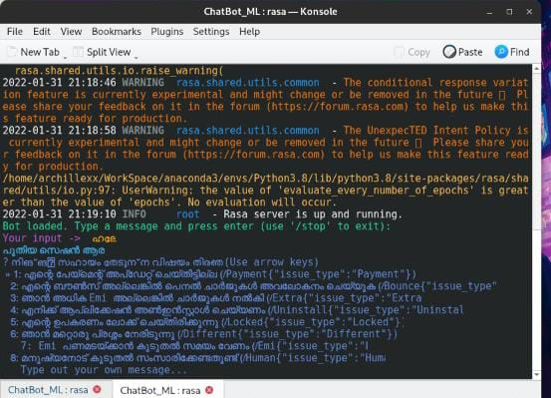
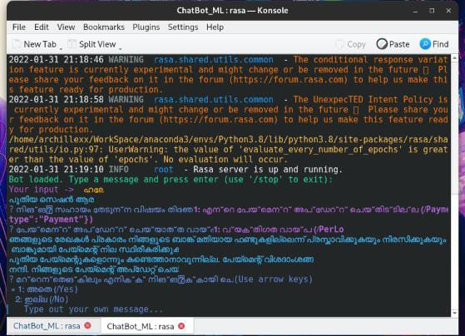
Experimental Results / Simulations / Observations
Results :
Working of the Bot :

Slide 6
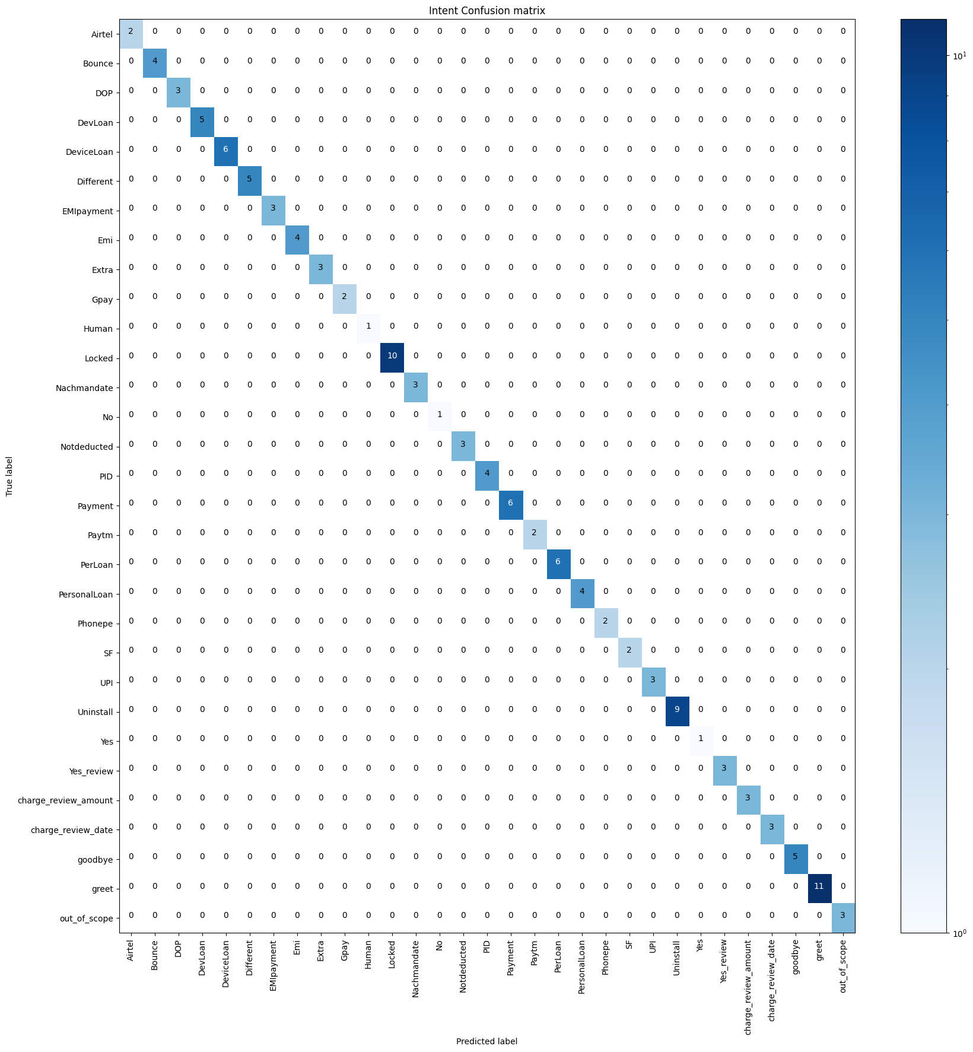
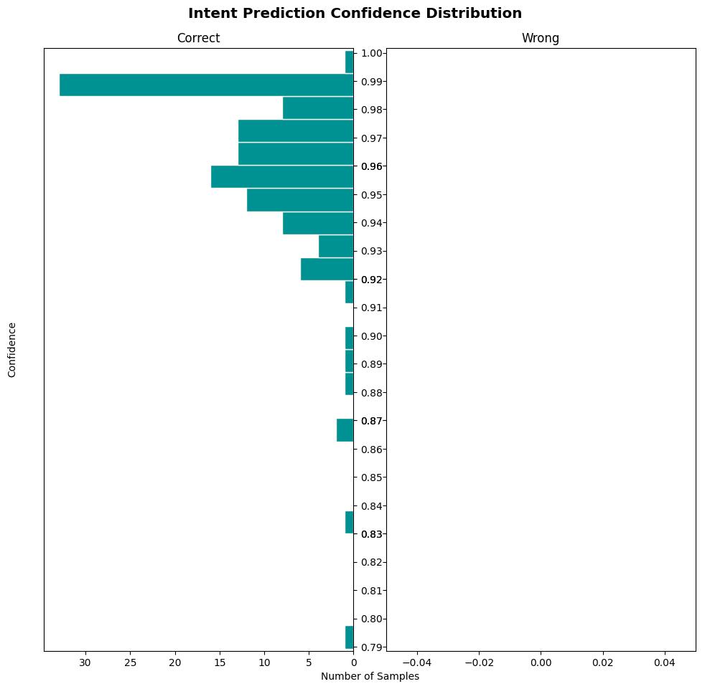
Experimental Results / Simulations / Observations
Validation Results :

Slide 7
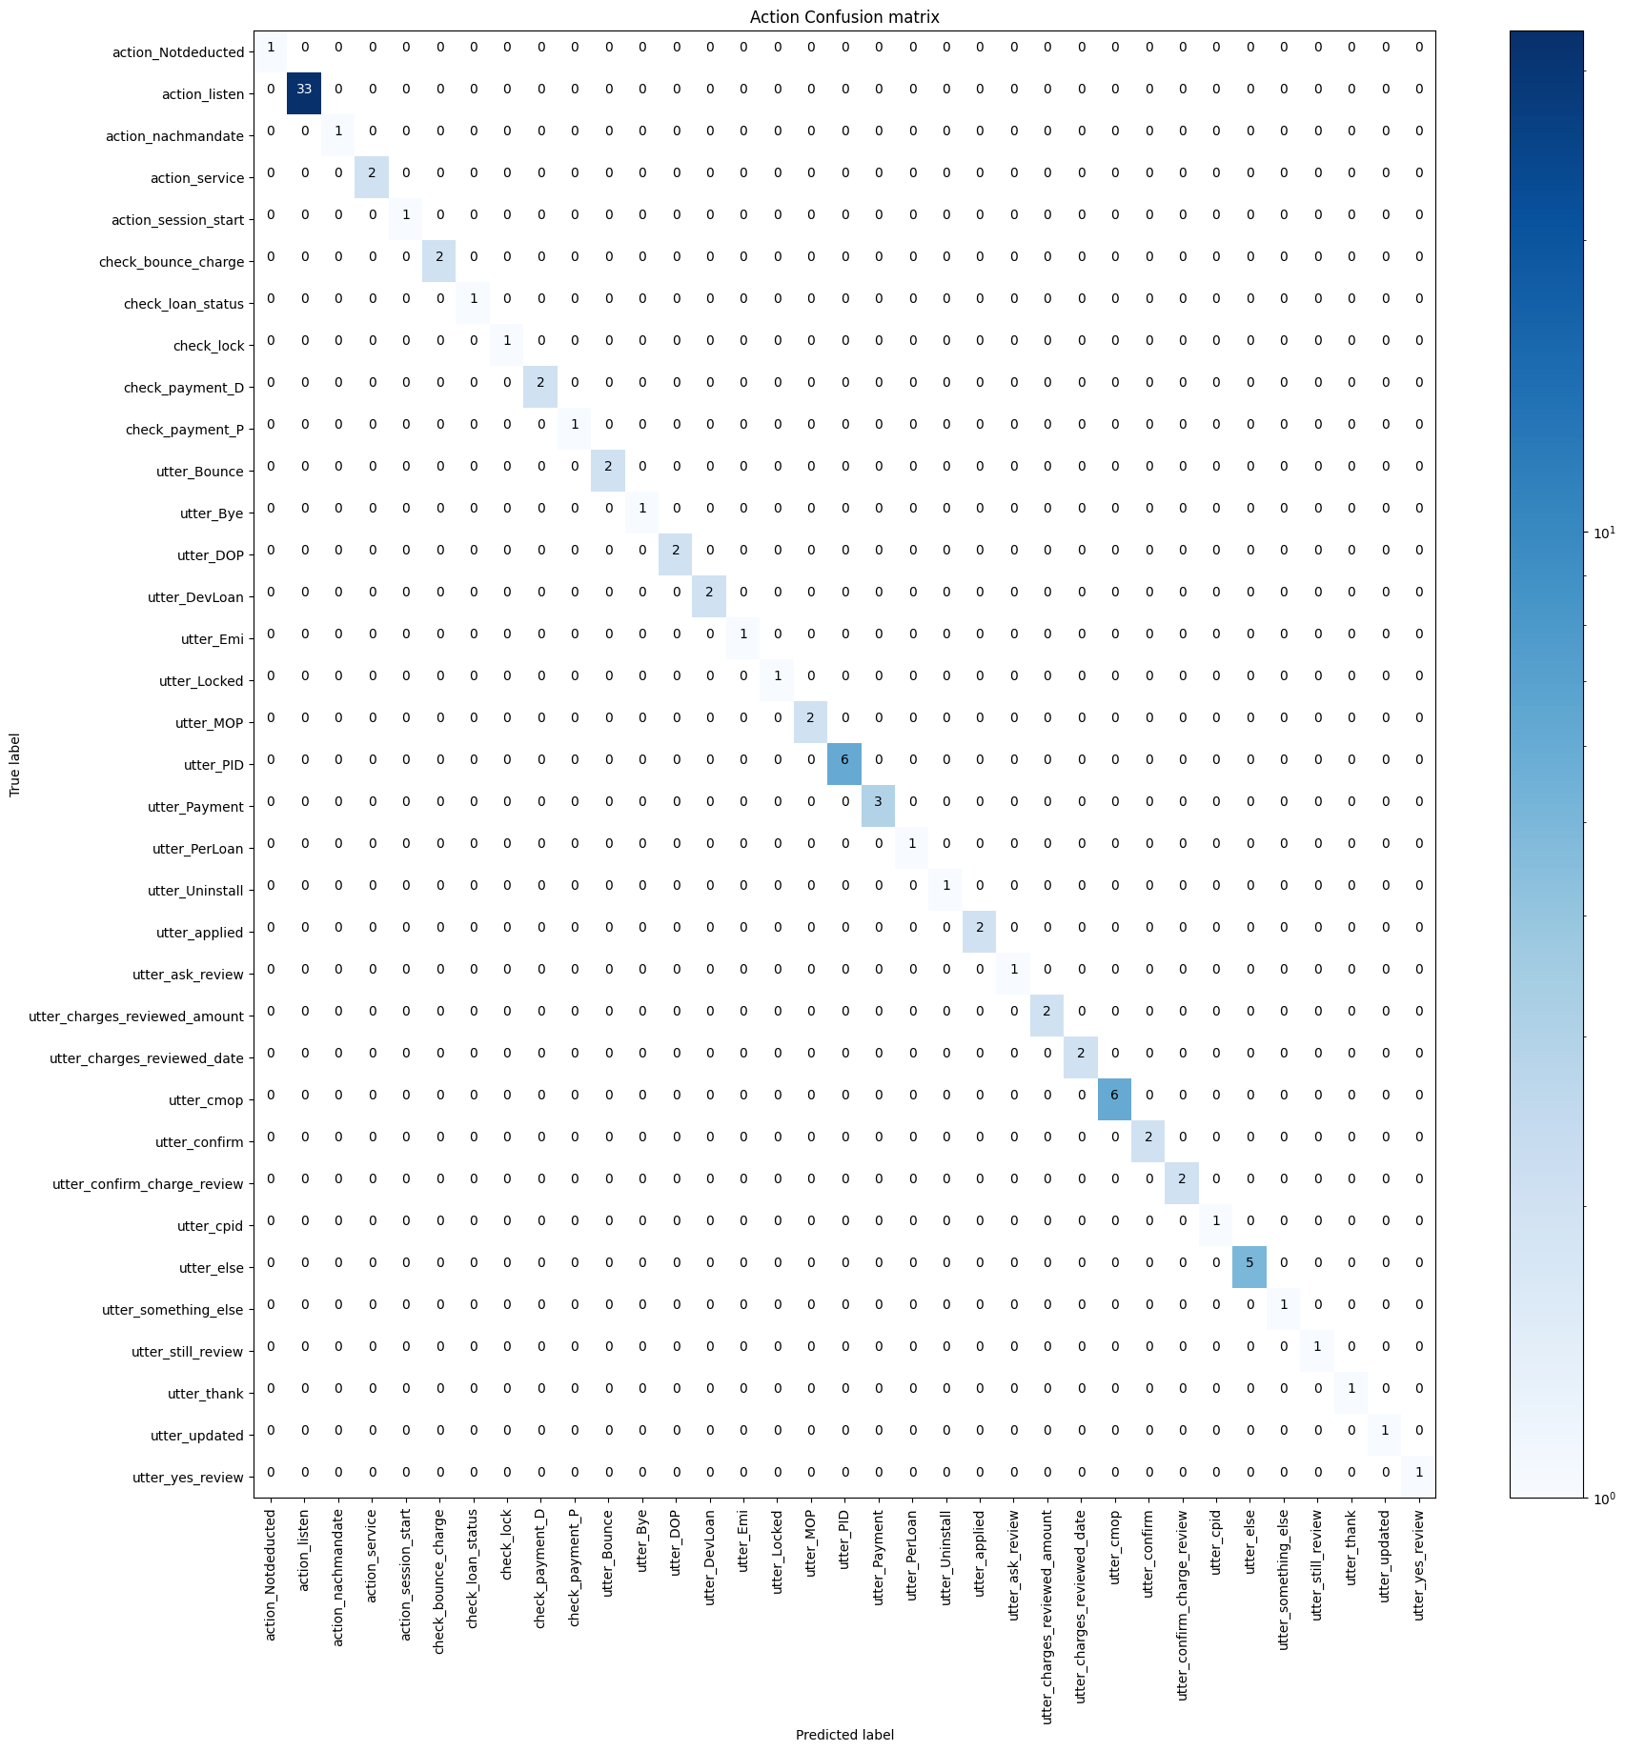
Experimental Results / Simulations / Observations
Major Observations / Conclusions & Challenges :
Integrating Fastext and Spacy into the Rasa Bot.
Scripts were only compatible until Rasa 2.8. Hence, Rasa 2.8 was choosen over Rasa 3.0, which is the latest available version of Rasa.

Slide 8
Deliverable
Final Deliverables :
Understanding of Rasa Framework.
Understanding of NLP.
Understanding of Transfer learning and Fasttext library.
Implementation of the Malayalam model on Rasa Framework using random data.
Implementation of the Malayalam model using the Samsung Datascripts.
Running of validation analysis test on the Bot.
IP / Paper Publication Plan :
If provided with the opportunity, we are interested to proceed further with Paper Publication.
KPIs delivered/Expectations Met:
Implementation of the Malayalam Chatbot using FastText and Spacy.
Survey done on an alternative to Jarvis.

Slide 9
Work-let Closure Details
Code Upload details:
Items | Details
KLOC (Number OF Lines of codes in 000’s)
Model and Algorithm details | Malayalam Chatbot
Is Mid review, end review report uploaded on Git ? | Yes
Link for Git | Repository Link
Data details (if applicable) : NIL
Items | Data folder 1 | Data folder 2 | Data Folder 3……..
Name & Type of Data (Audio/Image/Video)
Number of data points
Source of Data (self collected, Scrapped, available on open source)
Google drive link/ git link to access data
Note: If data uploaded on google drive, access to be shared to prism.srib@gmail.com

Slide 10
Thank you

